Slide 1
POEME’s methodology
for the creation of blended learning exhibitions
Webinar Training
Organized by:

Slide 2
Content of the webinar
1 – POEME’s methodology for the creation of blended exhibitions
Project’s innovation
Why use blended exhibitions?
How do we end up at an exhibition?
Brief presentation of the interactive e-Guidebook for POEME exhibitions
2 – Creating blended exhibitions at school
POEME sample exhibitions – Commandaria
Step-by-step guidance for the creation of a blended exhibition
Sample Exhibition Blueprints and Guidelines of POEME project

Slide 3
Project Presentation
France
Belgium
Portugal
Greece
Cyprus
Greece

Slide 4
POEME methodology for the creation of blended exhibitions

Slide 5
POEME Innovation
First goal
Second goal
Creation of e-Worksheets and eBooks, that aim not only at teaching language, but also equipping migrant students with digital and transversal skills and increasing their awareness of European cultural heritage. The materials provided can be used in face-to-face, blended or online formats.
Creation of blended exhibitions (digital and/or physical), with students as curators. The creation of these exhibitions will have a positive influence on the inclusion of migrant students in European schools, while contributing towards the students’ acquisition of 21st century skills.
Modernization of second language teaching both in content (EU cultural heritage) and way of assumed digital tools (E-Books/worksheets), as well as in the way students will work for language acquisition and cultural acknowledgement and for presenting their work (blended learning exhibitions)

Slide 6
Why is an exhibition the final step?
The POEME blended exhibitions have been chosen as the ultimate output (IO5), because the exhibition will need all skills acquired through the previous resources (written language acquisition, digital skills, knowledge on the importance of cultural and European heritage, vocabulary acquired):
IO1: Solid theory based on research has resulted to the e-Report with the POEME approach.
IO2: Complementary ready-to-use, hands-on activities and digitalized material for language acquisition, based on the content of cultural heritage, thus building on specific terminology and wording (E-worksheets).
IO3: Educators are given sample e-books and explanatory sheets, in addition to a webinar training and presentation on how to build their own using various software.

Slide 7
Why use blended exhibitions?
The multiple and diverse benefits further highlight the pedagogical use of exhibitions for learning in general, but also for language learning and integration in particular:
Teamwork
Critical and innovative thinking
Interpersonal and intrapersonal skills
Information literacy
Ability to apply what has been learned
Effective goal-setting and problem-solving
Knowledge-exchange
ICT and digital skills
Active engagement and participatory learning
Leadership and project management skills
Research and analysis of academic literature
Object research and construction skills
Presentation & communication skills

Slide 8
IO4: e-Guidebook for POEME exhibitions
Young curators will need to build on several skills for each of the steps of the exhibition.
The e-Guidebook invites students aged 12-18 years old and their teachers, to work collaboratively and provides concrete steps, tools and examples on building a POEME blended exhibition. Let’s see how it works

Slide 9
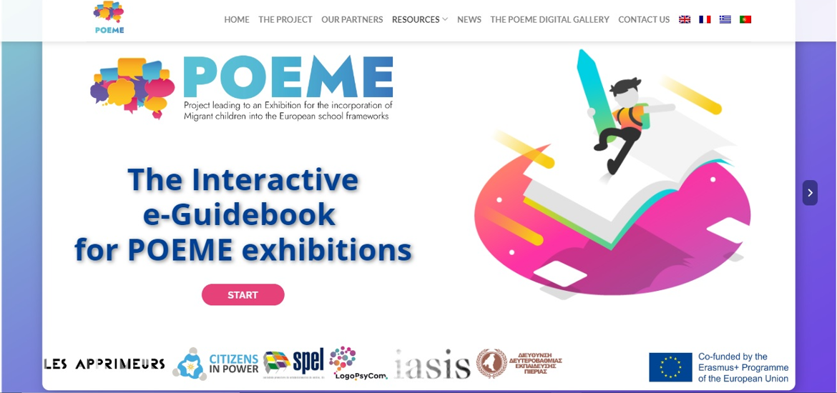
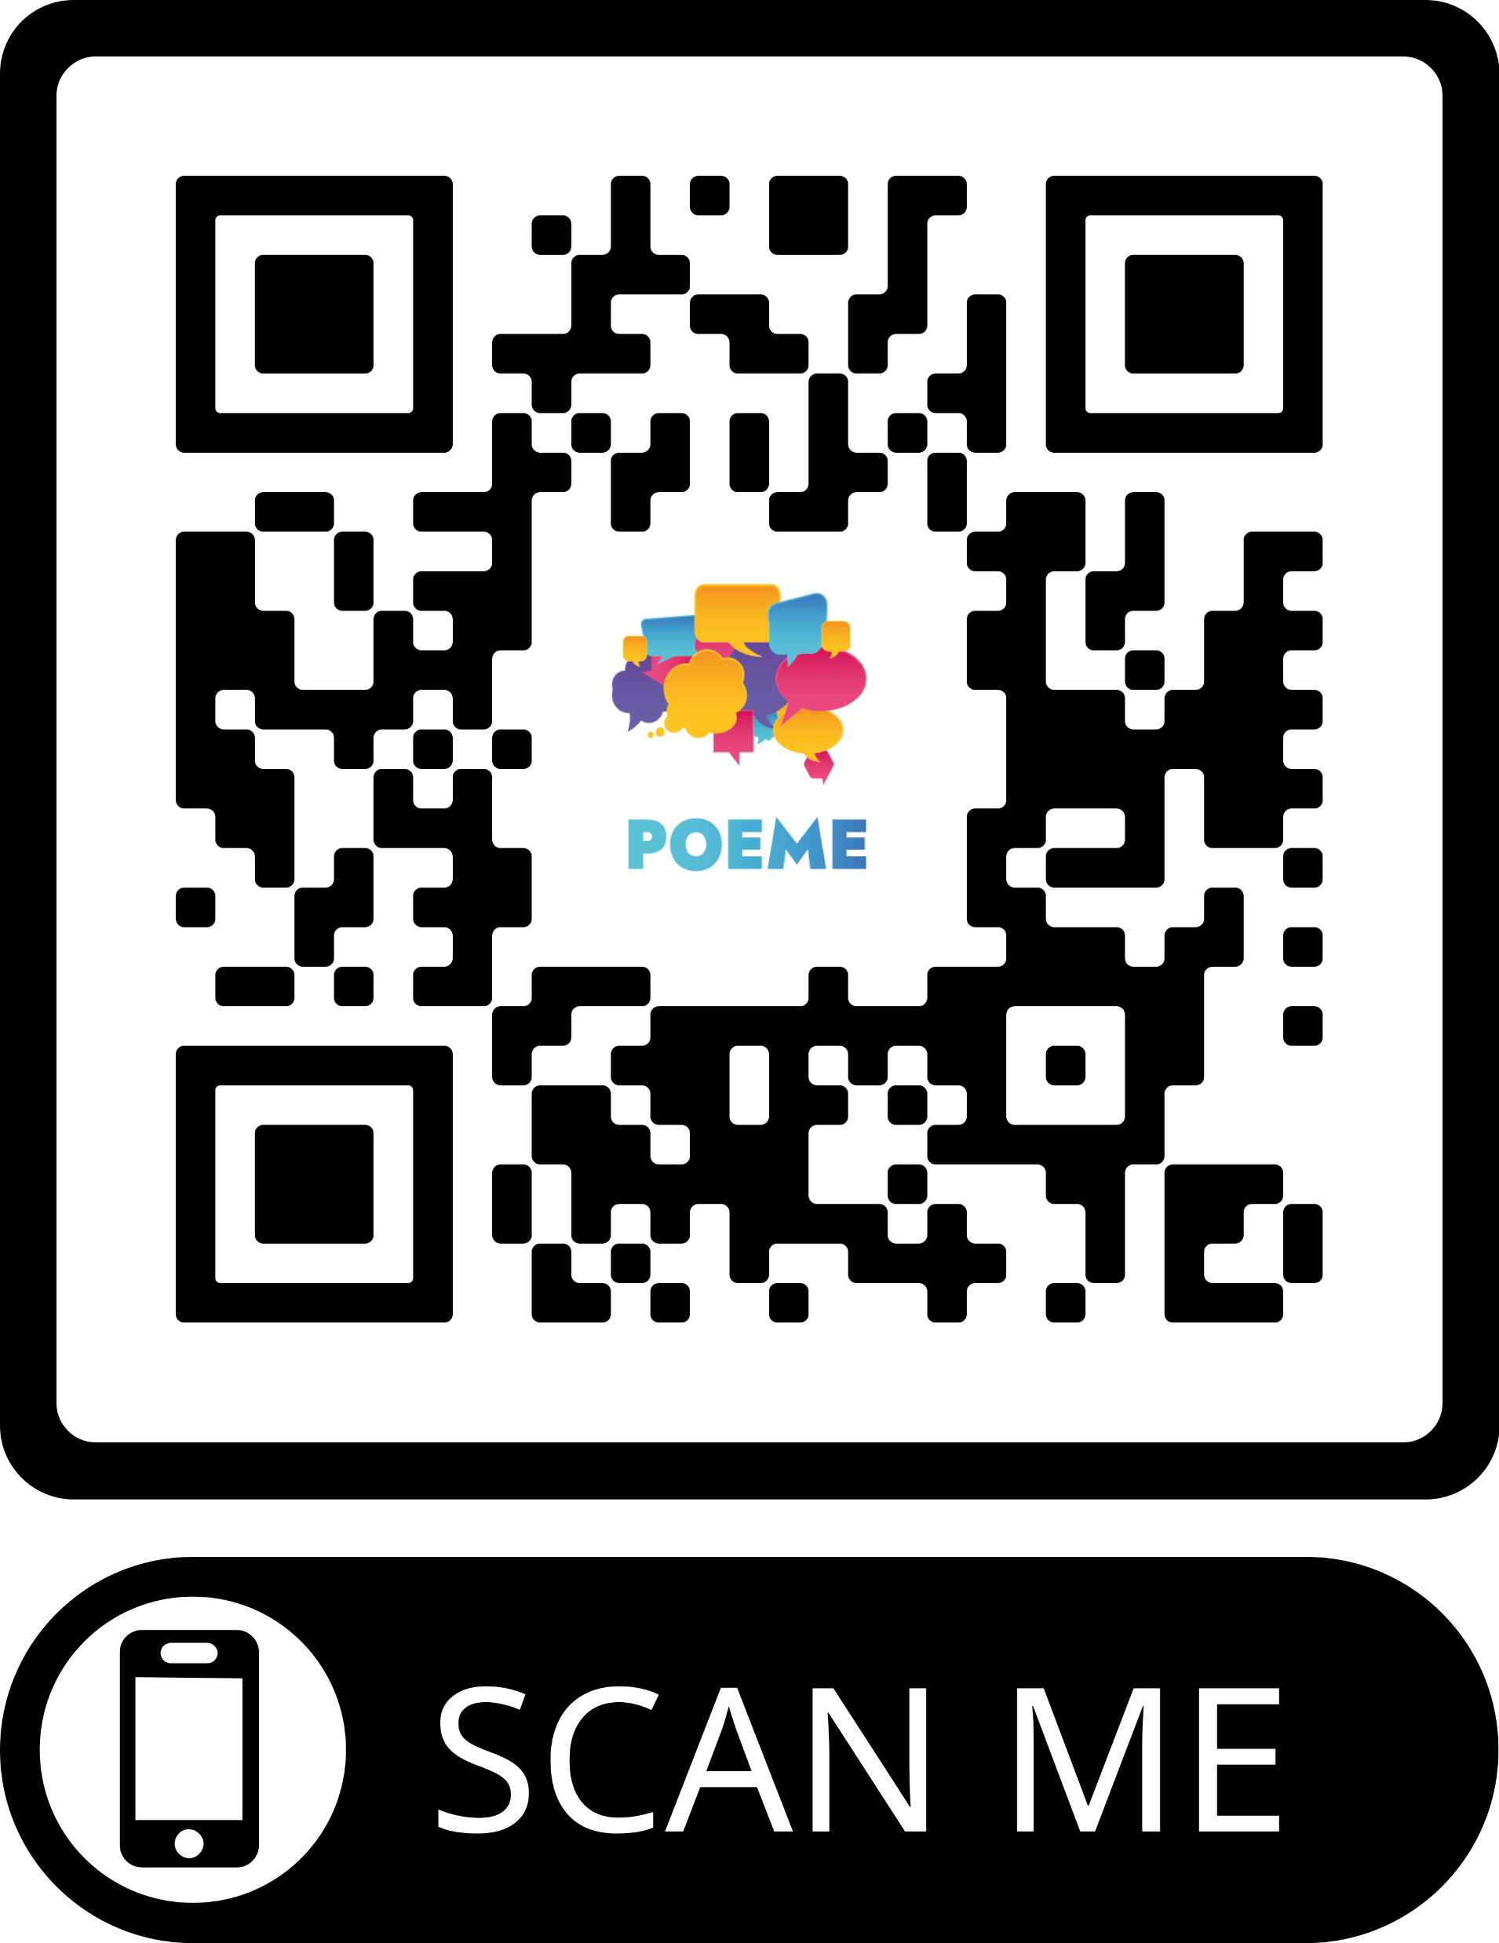
IO4: e-Guidebook for POEME exhibitions
Available online at: https://poemeproject.eu/io4-interactive-e-guidebook-for-poeme-exhibitions/

Slide 10
Creating blended exhibitions at school

Slide 11
POEME sample exhibitions
Partners have created 6 tailor-made blended learning exhibitions (digital & physical) following the components proposed by the POEME e-Guidebook that was presented previously.
These are accompanied by blueprints, providing guidance to educators and students through detailed steps & concrete examples.
These POEME exhibitions operate as ready-made samples to be viewed and explored, downloaded or printed through "The POEME Digital Gallery" on the project’s platform.
Let’s see an example, following step-by-step the instructions!
Notes:
The functionalities, as well as the interactive elements result in an e-book that is visually appealing and easy to use.

Slide 12
Building an exhibition step-by-step
Before you start, please note that...
An exhibition normally tells a story through objects, models, sounds, text, digital platforms, art, pictures, acts/performances. A student curated exhibition for your classroom or school would give great scope for object-based learning which also allows cross-curricular learning and inquiry-based learning as students delve deep into a chosen topic.
Follow the steps to help you organize your own classroom or school exhibition. These steps are a practical suggestion based on the “e-Guidebook for POEME exhibitions”.
Despite any suggestions, it is understood that there should be flexibility and adaptation to the needs of your class.

Slide 13
STEP 1: Plan the theme, set the goals
At an earlier stage of learning, you could use an e-Books and/or e-Worksheets (see POEME products as an inspiration). Through this work, the students will acquire (language, digital, communicative etc.) skills necessary to proceed with the creation of an exhibition.
Subsequently, spend some time asking the students in class, share observations to help you find out about their interests and plan your exhibition theme and set goals.
Example
Main theme of the exhibition: | Commandaria – “The Wine of Kings” and “the King of Wines”, is a cultural and traditional drink in Cyprus, originating from the Medieval Ages. This exhibition focuses on winemaking and its rich traditional history in the region of Cyprus and beyond.
Educational goals of the exhibition: | This exhibition aims to: Explore the history of Commandaria wine through visual representation. Enhance students’ visual expression through activities of creation. Enrich students’ vocabulary about winemaking and the Medieval Ages. Make students collaborate through the creation of exhibits, whilst enhancing their teamwork and communication skills. Showcase students’ talents and strengthen their self-confidence. Encourage them to discover Cypriot history

Slide 14
STEP 2: Develop sub-themes
Example
Decide how many sections your exhibition will be divided into. An ideal number is 3 sub-sections. What are the themes for each sub-section? What is the order of the sections? In groups, students can define the sub-themes. Develop inquiry questions to help them and encourage the use of a variety of resources including books, the internet and POEME products.
Important: the objects you will exhibit depend on the sub-themes you define.
Sub-sections (3) | Sub-themes (2-3)
1. Winemaking – Commandaria Making | Explore the winemaking regions The production Process Book The material used
2. Medieval Ages | A historical timeline The “Battle of the Wines” storytelling
3.Tradition | Commandaria as an art medium Branding & marketing traditional wine Exploring the Commandaria-making tradition

Slide 15
STEP 3: Select objects & decide exhibits
Think about what objects you want to include in your exhibition to tell its story (3 to 5 per sub-section). Consider the abilities and skills of your students; they can bring in something from home or create their own exhibits in a school lesson such as IT, arts etc.
Exhibits can be tangible, digital or intangible. They can also be interactive. If you choose to make a live blended exhibition, prefer an alternation of tangible, intangible and digital object. If you choose to create an online blended exhibition, you should ensure that even tangible and/or intangible objects can be digitized in some way.

Slide 16
STEP 3: Select objects & decide exhibits
As you collect objects, create a list. Write down the objects that are not ready and should be created.
Example
 | Name of the object | Type | Sub-section | Creation
1. | Mapping Commandaria Villages | Tangible/digital | Winemaking | YES
2. | Process Book Station | Digital | Winemaking | YES
3. | Mixed Up! – Make your own ‘Wine’ | Tangible | Winemaking | YES
4. | Becoming “Wine” Connoisseurs | Intangible/Tangible | Winemaking | YES
5. | A Historical Timeline | Tangible/ Digital | Medieval Ages | YES
6. | Battle of the Wines – Tell your own story | Intangible | Medieval Ages | YES
7. | Paint your Way | Tangible | Tradition | YES
8. | DIWine- Do-it-yourself-wine | Tangible/Digital | Tradition | YES
9. | Commandaria – A short film | Digital | Tradition | NO

Slide 17
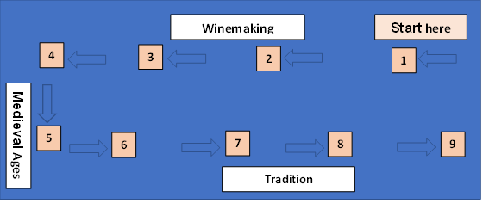
STEP 4: Design your exhibition
If your exhibition takes place physically, think about where it will be held (in the classroom, in the school hall, or in the school yard, which means outdoors) and draw a floorplan. How could you best use this space to display your objects and stories? Sketch the exhibition sections onto the floorplan.
If your exhibition is digital, decide how it will be displayed online. Will it be included in the school’s website or another? Will you create a separate blog just for this purpose?
Winemaking
1.Mapping Commandaria Villages
2. Grapes – Process Book
3. Mixed Up!
4. Becoming Wine Connoisseurs

Slide 18
STEP 4: Design your exhibition
Medieval Ages
Tradition
5. A Historical Timeline
6. Battle of the Wines – Tell your own story
7. Paint your way
8. DIWine – Do-it-yourself-Wine
9. Commandaria – A short film

Slide 19
STEP 4: Design your exhibition
Sub-sections | Object arrangement | Object display
Winemaking | 1.An explanatory map of Cyprus winemaking regions | Cyprus map printed out in large scale (zoomed) and placed on the floor with cut out labels to be glued on. If activity will be held digitally use a computer/tablet screen per student group (separate stations per group).
 | 2.Grapes – Process Book | Digital display on a screen (laptop/PC/tablet) placed on a table. Each group of students should have their own station with electronic device placed on a table/booth.
 | 3.Activity to create their “wine” from fruits | Table with materials to be used for creation. Students should have their own space to create their wine and all necessary tools. Table to display all creations in the end. The exhibit label will be placed on the wall on top of the table
 | 4.Activity: Becoming “Wine” Connoisseurs | Based on their judgment and knowledge rate, children are given a rating list to taste different flavors of juices.
Medieval Ages | 5.History of Commandaria Timeline | If physically, the timeline will be printed out in large scale and placed on the floor for students to place/write the events in chronological order. Make as many copies as relevant according to your groups.
 | 6.Battle of the Wines Performance | Theatrical performance – students will take the roles of characters from the Medieval ages and engage in dialogue through an imaginary story about Commandaria.
Tradition | 7. Paint your way | Space for paintings to be conducted (table/booth/floor space).
 | 8.DIWine – Do-it-yourself-Wine | Up-cycled bottles displayed as business ideas for new brands of Commandaria wines on a structure (table/box) no higher than 1.00 meter, in a row and with small labels below each one to indicate information about each bottle.
 | 9.Commandaria Short Film | Projection on a small wall or use of personal electronic device (TV/laptop/PC/tablet). Exhibit label placed next to the screening object.
Object arrangement & display
Discuss how you wish to group and arrange objects for display. The criteria you set depend on your main theme and the story you want to tell.
Think about how you will display your objects and stories. What additional resources you need to display. You can use the walls, old pieces of wood, a piece of furniture, cardboard boxes, folded paper for labels, or a projector, a tablet.
Example

Slide 20
STEP 5: Developing texts
You need to write:
an introductory text panel (poster or banner) to explain what the exhibition is about.
an introductory text panel for each section of the exhibition to explain the theme of the section. In an online exhibition, jpg or png form.
Exhibit labels to share information about what is on display (for all exhibits). You can use QR codes if you want to share more information. In an online exhibition, labels could be right next to or below the object picture, along with a relevant link in case we want to give more information material.

Slide 21
STEP 5: Developing texts
Examples of panels
Commandaria –
The Wine of the Kings
Commandaria is one of the oldest wines in the world and originates from the island of Cyprus. It has medieval roots, and it is a traditional dessert wine with rich flavor.
Winemaking of Commandaria
Also known as vinification is the production of wine, starting with the selection of the fruit, its fermentation into alcohol, and the bottling of the finished liquid. Explore the five essential stages of the wine-making process. Commandaria is made exclusively from two indigenous Cyprus grapes: Xynisteri and Mavro. The grapes are left to overripe on the vine, and they are harvested when sugar content reaches acceptable levels.
Medieval – Ages
Commandaria’s name is rooted in the Medieval Ages when the Knights Templar conquered Cyprus. Legend says that the Knights of St. John named the wine after the region of Commandaria in Cyprus, it was given different names throughout history. Deep down in the narrow stones of Cypriot forts, medieval knights enjoyed their food and wine, dancing and enjoying Commandaria.
Tradition
Commandaria wine has a long history, dating back to the time of ancient Greece when it was a popular drink at festivals. It is said that it’s the world’s oldest wine that is still in production. Commandaria holds a protected designation of origin (PDO) within the European Union, the United States, and Canada. According to Cypriot legislation passed on March 2, 1990, it is only produced in a region of 14 neighboring villages in Cyprus.

Slide 22
STEP 5: Developing texts
Examples of object labels
Exhibit 1 Label (taped on the wall above the life-size Cyprus map) Mapping Commandaria Villages There is a region in Cyprus called the Commandaria villages region, wherein, as the name suggests, Commandaria is produced. Found on the southern slopes of the Troodos Mountains, north of Limassol, the region comprises of 14 designated villages. Some of these include Lania, Trimiklini, Zoodoxos Pigi, Doros, Silikou and Monagri.
Exhibit 4 (taped on the wall near the tasting station) Becoming Wine Connoisseurs One thing you may not know, is that the art of winemaking creates many jobs in the labor market. One of these includes people who are called “wine tasters” and “wine connoisseurs”. While the process of creation is critical, it’s always important to taste it, assess its quality and evaluate it based on different criteria that will place it into different categories. Some of these criteria include its look (color, opacity[dark/light], texture[thick/watery], smell, and taste. Using these criteria, connoisseurs can identify how “strong” the drink is, how aged it is and how sweet it may be, among many others.
Exhibit 2 (taped on the wall) Process Book Station How does one create Commandaria? How would you outline the winemaking process? What types of grapes are used? Use your devices and start searching!

Slide 23
STEP 5: Developing texts
Examples of object labels
Exhibit 3 (taped on the wall near the winemaking station) Mixed Up! There is a certain “magic” to the art of creating something rather than just experiencing it. This messy play activity involves an interactive way of “making wine”. Use the materials on the table and use your knowledge from Exhibit 2 to create your own wine. Roll up your sleeves, put on your aprons, and get creative!
Exhibit 6 (on role-play station, next to props and guidelines) Battle of the Wines – Tell your own story What would it feel like to live in the Medieval Ages? In this part of the exhibition, you are called to engage in a re-enactment of events. Place yourselves in the shoes of the King Phillip II of France, or a common priest ready to promote his wine. What would characters of this era say? How would they act? What would they wear? Let your imagination run wild!
Exhibit 5 (taped on the wall near the life-size timeline) A History Timeline Behind every great invention there comes a long history related to its origins story and how it became successful. There are at least 4 very important events related to the making of and origin of one of the most famous dessert wines in the world. Read the text provided, use your intuition, and place those events on the timeline to map out Commandaria’s history.

Slide 24
STEP 5: Developing texts
Examples of object labels
Exhibit 7 (taped on the wall above the drawing station) Paint your way Apart from its historical, social, and religious attributes, Commandaria can be used as a creative medium for expression. Using all you have learned about this sweet dessert wine, use it to draw a related representative or non-representative drawing. What does this mean to you? Give your creation a catchy title and start drawing!
Exhibit 9 (taped on the wall next to the screen/projector) Commandaria – A short film Step inside the world of Commandaria making. What does the process of creation look like? What does it sound like? Place yourselves in context and use your senses to enjoy the whole experience. The typical steps of Commandaria-making are as follows: 1. Harvest 2. Drying 3. Crashing 4. Fermentation 5. Aging 6. Serving
Exhibit 8 (taped on the wall above the branding station) DIWine – Do-it-yourself-Wine It is one thing to create an exceptional-quality product, but it takes a great marketeer to make it successful. It may come as a surprise, but most people buy wine based on the label on its bottle. Sometimes all it takes is a great design or an attractive package, but sometimes it’s all about the story behind it. What makes a product unique? Do it yourself and define your product’s Unique Selling Point. Let the best design win!

Slide 25
STEP 5: Construct your exhibits
Following the previous steps and in perfect agreement with them, it's time to build your exhibits.
Before construction, you will need to create a blueprint that will be accompanied by appropriate explanatory images or/and designing plans.
The blueprints are necessary for better organization but also for the division of tasks between students. Assign groups of 2-4 students to create an exhibit.

Slide 26
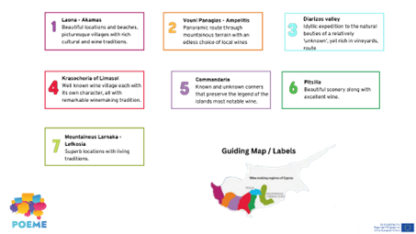
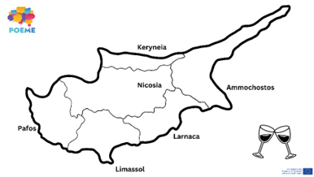
STEP 5: Construct your exhibits
Sub-section: | Winemaking
Exhibit number: | 1
Name of the exhibit: | Mapping Commandaria Villages
Type of exhibit: | Tangible or digital
Recommended preparation time: | 30 minutes
Required students: | Groups of 2-4 students
Brief description: | An explanatory map of Commandaria and other vineyards of Cyprus. The map presents the location of vineyards in Cyprus where Commandaria wine is mainly produced and are considered as Commandaria-verified regions.
Materials and/or tools needed: | Exhibit 1 Resource: Explanatory Map (printed out or digital) Descriptive labels (printed or digital) Digital device (optional) Collage materials (glue, paper, blu tac) Space to lay out map or table & plug for electronic device
Dimensions of the exhibit: | The physical dimensions of the map and the labels are proportional according to the size of the map given. For example, if the map is 150 x 100 cm, the labels will be 10 x 5 cm. The digital map is the same.
Step by step construction instructions: | Step 1: Prepare the materials needed according to the number of students. It is suggested to give 1 map to a group of max 4 students. Provide students with collage materials and prepare labels in advance (print or digital). Step 2: Pass the maps and show them the basic features of the map. Step 3: Let them explore the map for 2-3 minutes. Step 4: Students start collaging the labels in the right place. PS. The map can be enlarged as much as needed, and presented both digitally and/or in printed format
Example

Slide 27
STEP 5: Construct your exhibits
Sub-section: | Winemaking
Exhibit number: | 2
Name of the exhibit: | Process Book Station
Type of exhibit: | Digital
Recommended preparation time: | 30 minutes
Required students: | Groups of 2-4 students
Brief description: | It is a book that will outline the winemaking process. It will outline the two types of indigenous Cyprus grapes and at least five of the main stages of Commandaria production.
Materials and/or tools needed: | Students will use a digital device (phone/tablet/laptop) to research the main steps and find the best images for every step. Create a digital album of images using book creation software. Recommendation: Book Creator or Canva. Students can also use the POEME Commandaria e-book and/or worksheet
Dimensions of the exhibit: | Digital format – can be viewed digitally or downloaded as an e-pub file. They can use any medium they already engage with.
Step by step construction instructions: | Step 1: Start the research process Step 2: Collection of photographs of the process (reference images) Step 3: Use Book Creator or Canva to create a Process Book with audiovisual material Step 4: At the end, students will give feedback and comment on their albums
Example

Slide 28
STEP 5: Construct your exhibits
Sub-section: | Winemaking
Exhibit number: | 3
Name of the exhibit: | Mixed Up!
Type of exhibit: | Tangible
Recommended preparation time: | 30-40 minutes
Required students: | Individual activity, students can come together as a group in the end
Brief description: | This is a messy play activity where students can engage in the process they explore in the previous exhibit. They will be given fruits and juices to crush using their hands and tools to make their own “wines”. The activity is meant to be experiential and help them better engage with the process of mixing materials and creating something from scratch.
Materials and/or tools needed: | Variety of seasonal fruits & juices / Kitchen tools (measuring cup, spoons, peeler, etc.) /Food smashing objects (e.g., food smasher, blender, juice squeezer etc.) / Aprons / A3 paper / Table
Dimensions of the exhibit: | Messy play – Experiential activity
Step by step construction instructions: | Step 1: Each student will select 2-3 fruits and one juice flavor. Step 2: Students will try to engage in the creation process by mixing the fruits and juices together, picking their own analogies to create “wine” from scratch. Students will need to keep a record or “recipe” during their process. Step 3: Students will present their product; explain how they made it and can try out each other’s creations to compare. Step 4: Using the A3 paper, students will collectively create a wine-book, with a collection of all their recipes.
Example

Slide 29
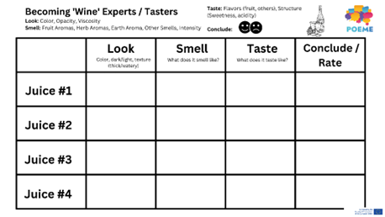
STEP 5: Construct your exhibits
Sub-section: | Winemaking
Exhibit number: | 4
Name of the exhibit: | Becoming “Wine” Connoisseurs
Type of exhibit: | Tangible and/or Digital
Recommended preparation time: | 15-20 minutes
Required students: | Individual activity (groups of 1)
Brief description: | The rating activity will be an introduction to wine experts and wine tasters. Students will become familiar with these processes by practicing their tasting skills. Juices will be used instead of natural wine for this activity, and the process will be the same. Students will rate the “wine” according to its look, smell, and taste and then add an overall conclusion/rating.
Materials and/or tools needed: | Exhibit 4 Resource: Wine Expert Rating Activity (or something similar) / Pens/markers / 4 types of juices / Glasses/cups/ Table
Dimensions of the exhibit: | The activity does not have a dimension/form/format. The rating activity can be executed digitally using electronic devices or physically by printing out A4 copies of the rating activity table. Tasting can only be done physically.
Step by step construction instructions: | Step 1: Introduction to Wine experts and the variety of jobs in the wine factory Step 2: Explanation of the tasting and rating handout. Step 3: Tasting begins. Students will be asked to express their opinion regularly during this activity. They will note down their observations individually or in small groups *Handout resource in pdf format (physical or digital).
Example

Slide 30
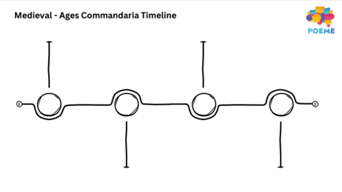
STEP 5: Construct your exhibits
Sub-section: | Medieval Ages
Exhibit number: | 5
Name of the exhibit: | A Historical Timeline
Type of exhibit: | Tangible and/or Digital
Recommended preparation time: | 15 minutes
Required students: | 5-6 students per group
Brief description: | This activity aims to explore the medieval Ages and the history of Commandaria. Students are asked to read a text on Commandaria, note down the most important events related to its history and then place them chronologically on the timeline provided.
Materials and/or tools needed: | Exhibit 5 Resource: Timeline Text (or something similar) Exhibit 5 Resource: Commandaria History timeline (printed pdf or digital) (or something similar) Pens & Papers or electronic device POEME Commandaria E-worksheet and/or E-book (optional)
Dimensions of the exhibit: | Life-size historical timeline (accordingly to the available floor/wall space)
Step by step construction instructions: | Step 1: Share the written text on Commandaria’s history with students Step 2: Students read the text and highlight the most important events throughout its history Step 3: Students use the timeline to place the events chronologically. Step 4: Hold an open discussion in the case where students have very different answers and ask to explain their choices. *Resource given in pdf format (physically or digitally)
Example

Slide 31
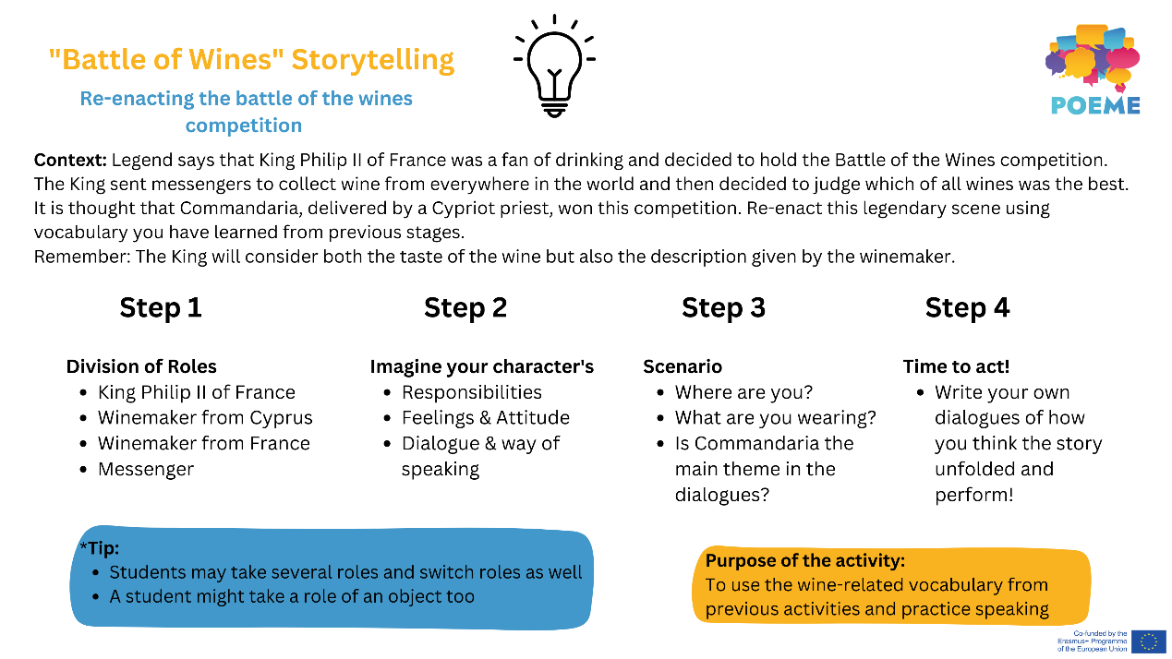
STEP 5: Construct your exhibits
Sub-section: | Medieval Ages
Exhibit number: | 6
Name of the exhibit: | Battle of the Wines – Tell your own story
Type of exhibit: | Intangible and/or digital
Recommended preparation time: | 30-45 minutes
Required students: | 2-4 students per group
Brief description: | Students are asked to take the roles of characters during the Medieval Ages and create dialogues in an imaginative story to re-enact the Battle of the Wines competition organized by King Philip II. Students are expected to improvise in an acting activity and try to use the vocabulary learned so far from previous activities.
Materials and/or tools needed: | Exhibit 6 Resource: Storytelling guidelines (or something similar) Commandaria wine bottle Other wine bottles (preferably from different countries) Chair (for King) Medieval Ages related props (optional) Medieval Ages costumes (optional) Camera for recording/projector (optional)
Dimensions of the exhibit: | Role Play Activity – acting performance. The activity can be performed once physically and then recorded to be displayed digitally (using a projector/screen) in a loop for the remaining duration of the exhibition.
Step by step construction instructions: | Step 1: Read the Exhibit 6 Resource and divide the roles to students (or something similar) Step 2: Students brainstorm and create a fictional dialogue with their characters related to the period and the Battle of the Wines Step 3: Students perform their work to everyone Step 4 (Optional): Students can record their performance once and then display it using a projector in a continuous loop
Example

Slide 32
STEP 5: Construct your exhibits
Sub-section: | Tradition
Exhibit number: | 7
Name of the exhibit: | Paint your Way
Type of exhibit: | Tangible
Recommended preparation time: | 20 minutes
Required students: | Individual activity or in pairs
Brief description: | This activity seeks to use Commandaria as an artistic medium to create either representative or non-representative drawings – ideally related to the wine itself. The final result will be exhibited in the space available and students can also add a small description and label of their painting (in the classroom, hall, etc.).
Materials and/or tools needed: | A3 watercolor paper for each student Commandaria wine Aprons Paint brushes/painting tools Pins and/or Blu Tac (for display) Grape leaves & branches (optional) Tables/small stations
Dimensions of the exhibit: | Activity can take place in a classroom, art studio or open space where students have the space to paint and experiment with the artistic medium. Each student can have their own station (table, booth, etc.) to work on individually
Step by step construction instructions: | Step 1: Students will be introduced to using Commandaria as a medium to paint. Step 2: Using Commandaria wine as an ‘ink’ medium and/or materials which make up Commandaria wine, students will create their own artistic creations Step 3: Ask students to write a small description of their piece of art and add a label with the title of the painting Step 4: Compile a collection of the paintings for display in the classroom or school rooms.
Example

Slide 33
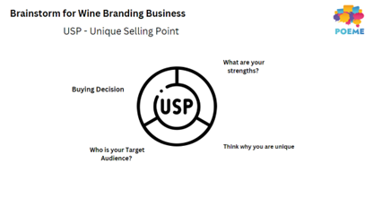
STEP 5: Construct your exhibits
Sub-section: | Tradition
Exhibit number: | 8
Name of the exhibit: | DIWine – Do-it-yourself-Wine
Type of exhibit: | Tangible or Digital
Recommended preparation time: | 25-30 minutes
Required students: | 2-3 students per group
Brief description: | In this activity, students will learn how to brainstorm about a product’s Unique Selling Point (USP) step by step. They will first brainstorm about the different points provided on the template, and then proceed to create a catchy logo and brand title. They will use their abilities to market and customize their brand idea to try to “sell” it to potential buyers.
Materials and/or tools needed: | Exhibit 8 Resource: USP Brainstorming (or something similar) / Re-used or recycled Wine/Commandaria Bottles / Adhesive/non-adhesive Labels / Paper / Pens & colorful markers / Electronic device (optional – for research and/or printing/designing) / Tables/small stations
Dimensions of the exhibit: | The activity can be conducted digitally using design software such as Canva to model a brand and complete the brainstorming digitally. If done physically, student groups should have a dedicated space in the room to lay their materials and sketch out their ideas.
Step by step construction instructions: | Step 1: Brainstorm for wine business ideas Step 2: Complete the USP parameters Step 3: Design the Logo Label and the bottles Step 4: Present their product to the rest of the class and try to “sell” it – market it (Optional) Step 5: Students can vote the group whose design and marketing pitch is believed to have been most effective
Example

Slide 34
STEP 5: Construct your exhibits
Sub-section: | Tradition
Exhibit number: | 9
Name of the exhibit: | Commandaria – A short film
Type of exhibit: | Digital
Recommended preparation time: | 5-10 minutes
Required students: | All students
Brief description: | In this activity, students will learn how to display a digital video with the equipment available. Using audio devices and monitors to set up the display. They are expected to be well informed about the video as questions may be asked at the end.
Materials and/or tools needed: | Exhibit 9 Resource: Commandaria Short Film (or something similar) Monitor & Speakers Screen/Laptop/Projector
Dimensions of the exhibit: | Display of work. Wall or screen size depends on the space available. A TV screen or laptop could be also suitable.
Step by step construction instructions: | Step 1: Set up devices on which to watch the video (e.g., projector, screen, laptop, sound etc.) Step 2: Watch video & take notes Step 3: Prepare for questions
Example

Slide 35
STEP 6: Launch your exhibition
Create posters and flyers using persuasive language which entices your audience to want to come along.
Create a list of who you want to invite to your exhibition and send invitations via e-mails.
Plan an opening event which might include speeches, spots etc.

Slide 36
Finally…do not forget…

Slide 37
The most important part, is that the students create the exhibition on their own depending on their interests, skills and abilities.
Successful completion of the exhibition means that, at the end, the students had fun, learned, collaborated and gained unique experiences.
This is what POEME project is aiming at. We encourage you to try this approach as well when teaching in a multicultural class.

Slide 38
WOULD YOU LIKE TO BE A PART OF THIS?
Participating schools are kindly asked to take part in a national online workshop, where exhibitions created by the students in the language of the host country will be virtually or physically curated and presented.
The best 6 exhibitions created by students across the consortium countries will also be added on “The POEME Digital Gallery”, along with the 6 sample blended exhibitions, thus generating a virtual exhibition of the artifacts.

Slide 39
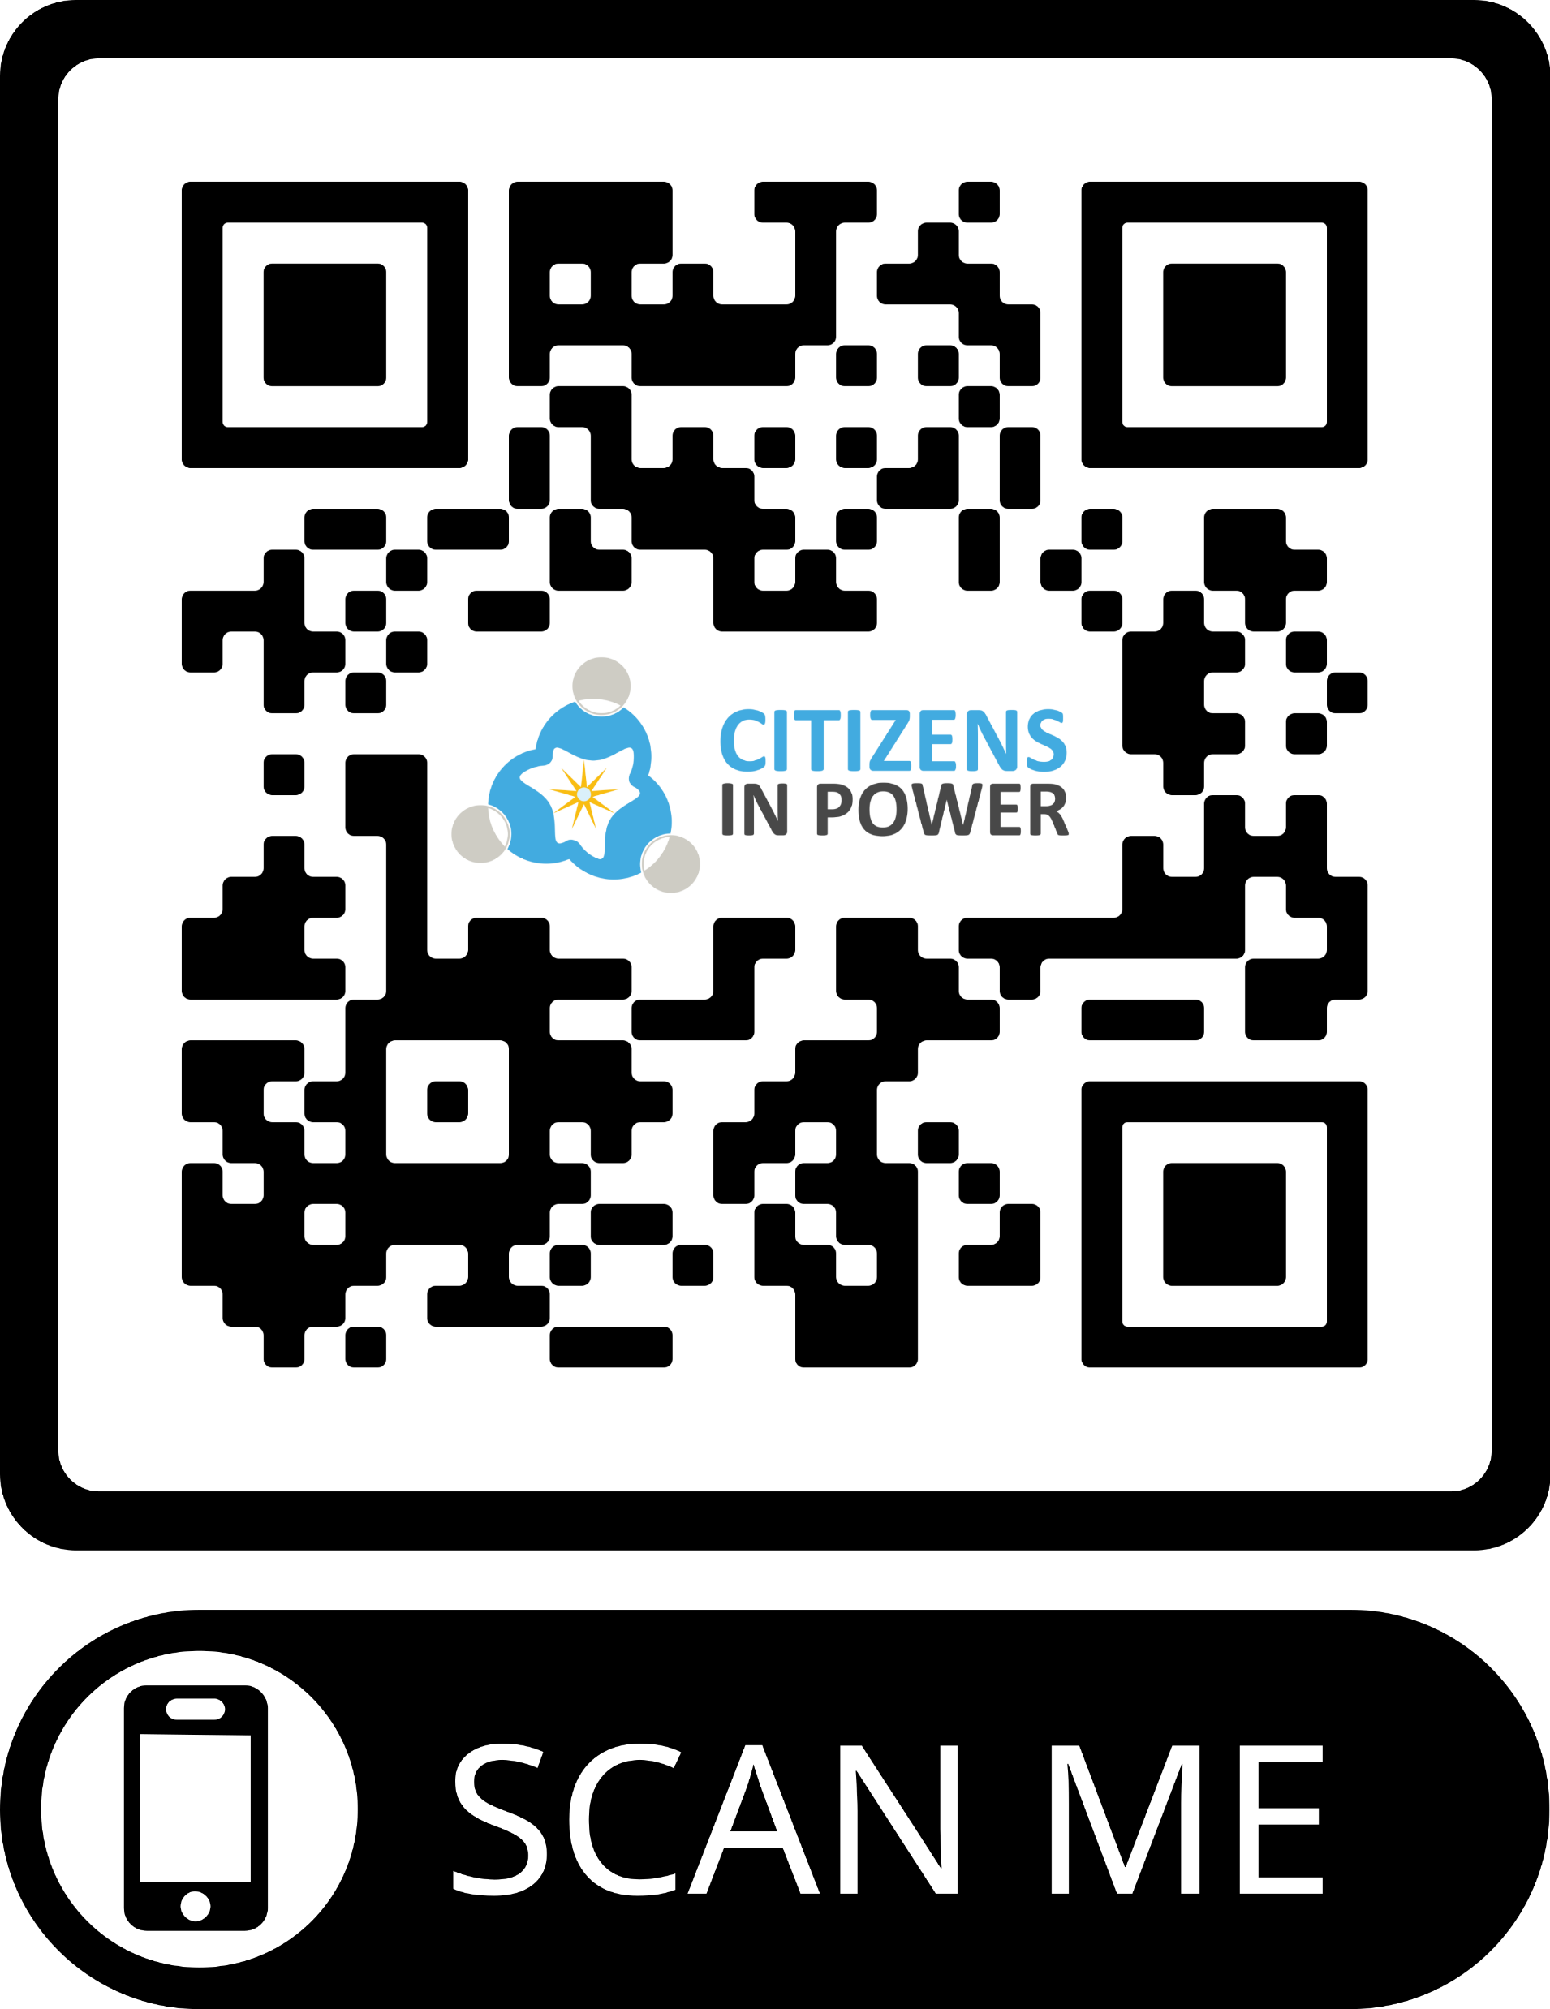
Please take two minutes to scan the QR code to evaluate this webinar

Slide 40
Contact point for information and collaborations: Louiza Kythreotou Email: louiza.k@citizensinpower.org Phone: +357 97611738
Thank you!
Check out the POEME website and social media:
 www.poemeproject.eu
www.facebook.com/POEMEproject
The European Commission's support for the production of this publication does not constitute an endorsement of the contents, which reflect the views only of the authors, and the Commission cannot be held responsible for any use which may be made of the information contained therein.

